Slide 1



Making Health Economics Shiny: A tutorial
Robert Smith & Paul Schneider
ScHARR, University of Sheffield

Slide 2



Who we are
Robert Smith
Paul Schneider

Slide 3

Tutorial Information
Open Access Content Available here: https://robertasmith.github.io/healthecon_shiny/
Including:
Academic Paper
Tutorial
App code

Slide 4
Prerequisite knowledge
R programming:
Functions
Objects
Loops
Packages
Plotting
Health economics:
Markov Model
QALYs
ICERs
PSA
Cost-effectiveness Plane
CEAC

Slide 5

Background

Slide 6

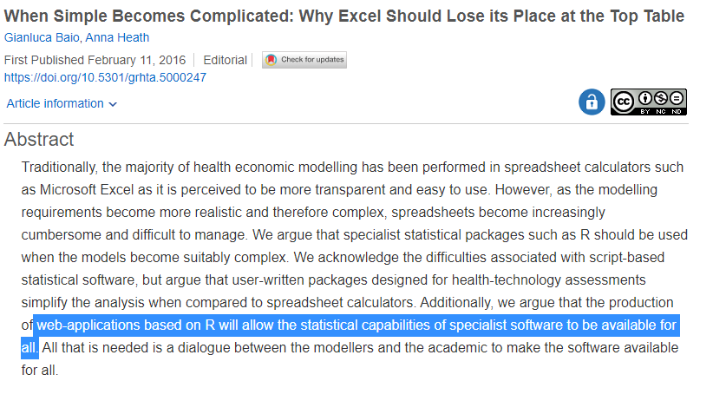
Background
“The future of cost-effectiveness modelling lies in web-apps, in which graphical interfaces are used to run script-based models”

Slide 7
Current Process
Input
Model
Output
Plots
Present

Slide 8
Future process?
Input
Model
Output
Plots
Present

Slide 9
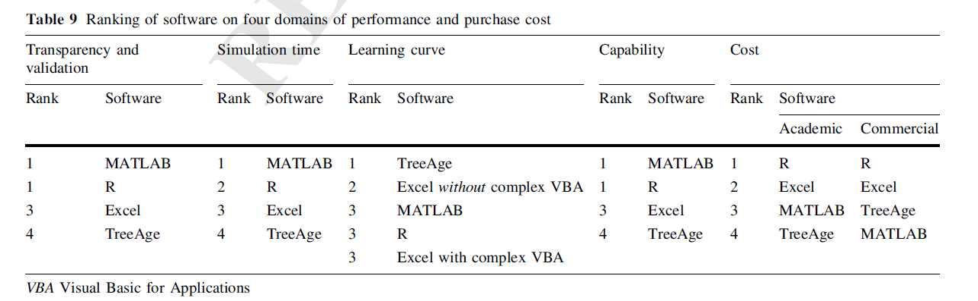
R for Decision Modelling?
Hollman, C., Paulden, M., Pechlivanoglou, P. and McCabe, C., 2017. A comparison of four software programs for implementing decision analytic cost-effectiveness models. Pharmacoeconomics, 35(8), pp.817-830.

Slide 10



Teaching and Tutorials

Slide 11


Who is teaching what?
Input
Model
Output
Plots
Present

Slide 12
Examples

Slide 13
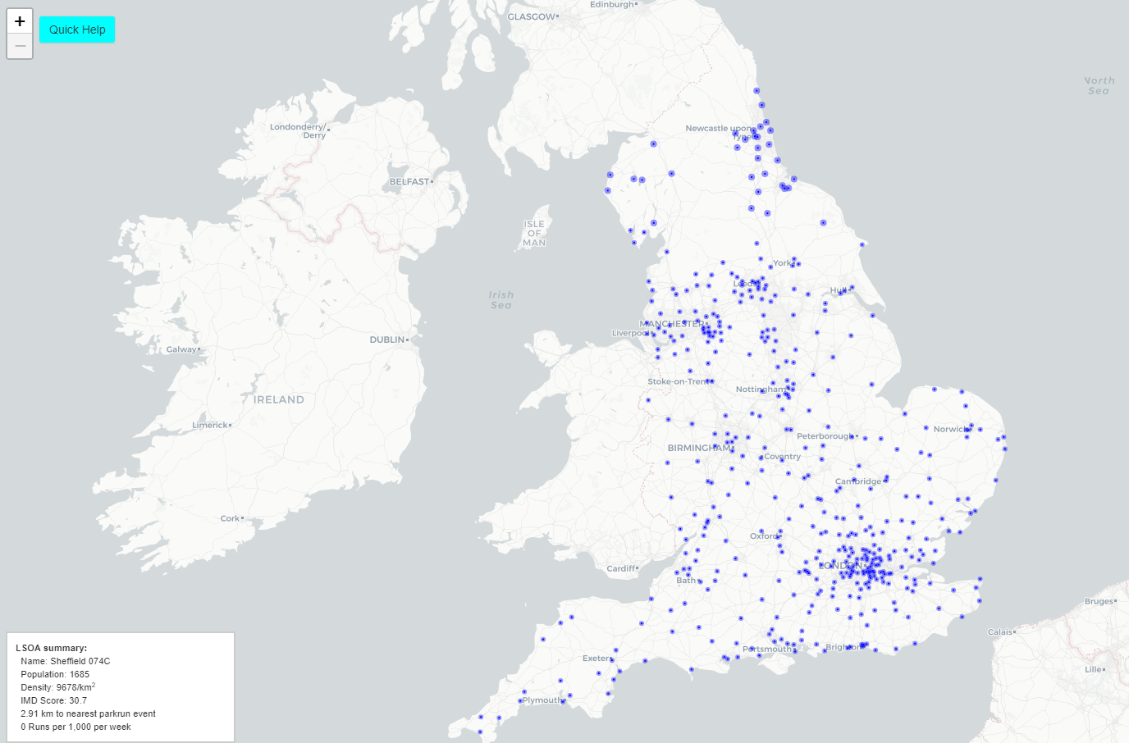
Where should parkrun locate new events?
http://iol-map.shef.ac.uk/

Slide 14

World Health Organization - FGM Model
https://srhr.org/fgmcost/

Slide 15
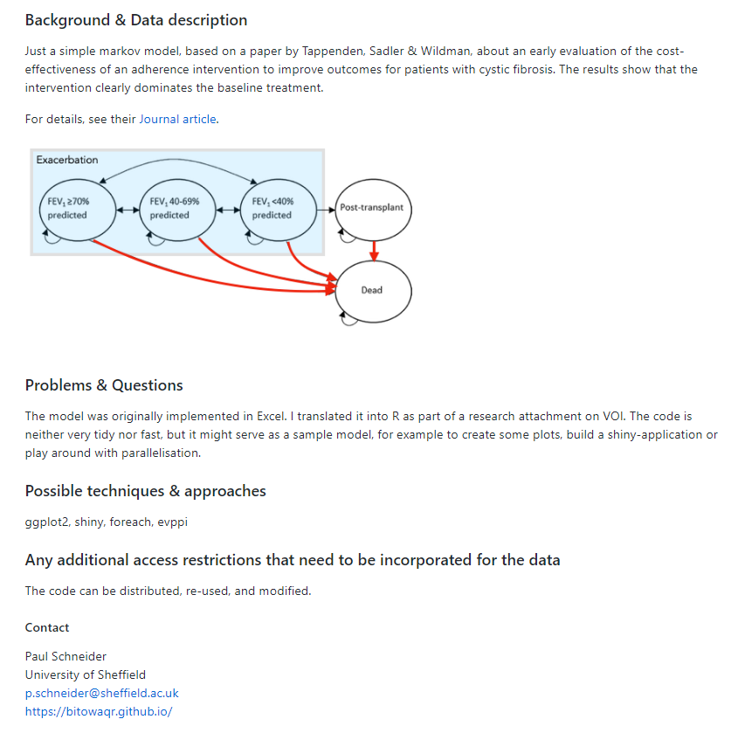

Cystic Fibrosis Adherence
https://github.com/HealthEconomicsDataDive/shiny_s5

Slide 16
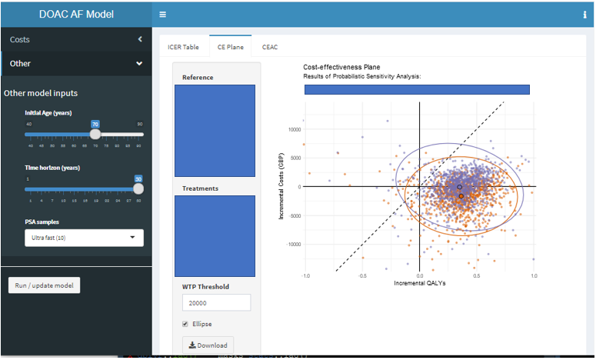
Health Technology Assessment

Slide 17
Tutorial

Slide 18
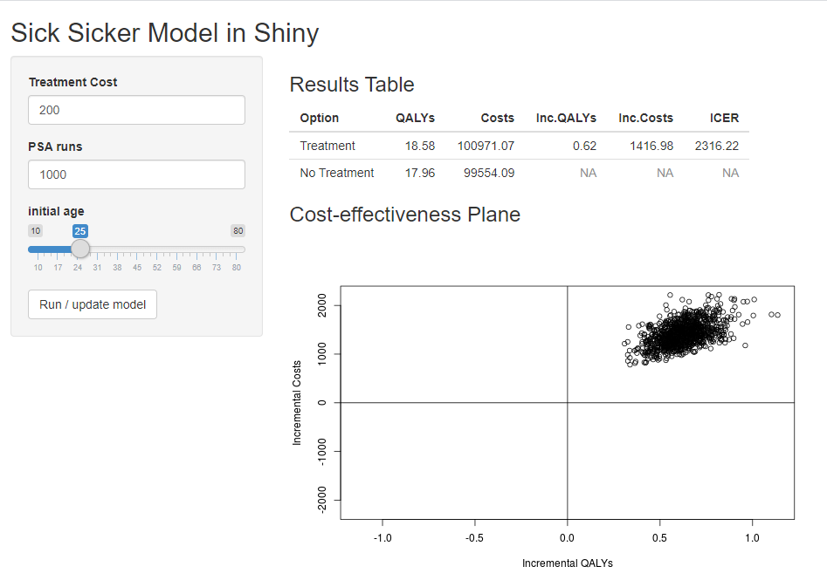
Simple App
https://robertasmith.shinyapps.io/sick_sicker/

Slide 19
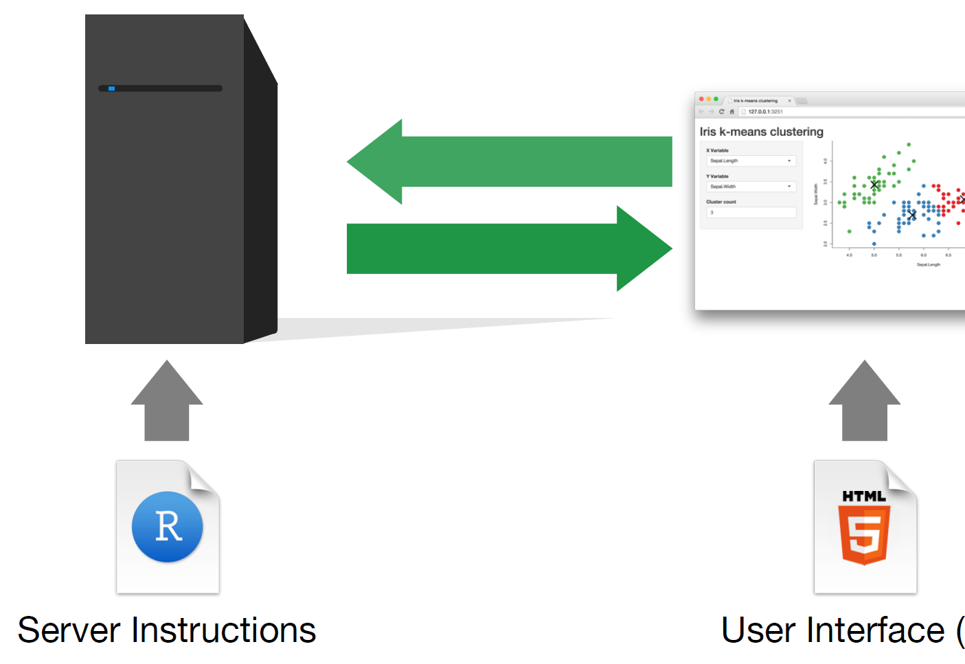
How does Shiny work?

Slide 20
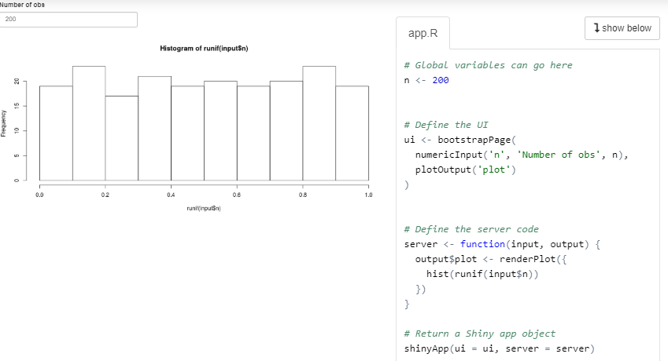
Simple shiny application
https://shiny.rstudio.com/gallery/single-file-shiny-app.html

Slide 21
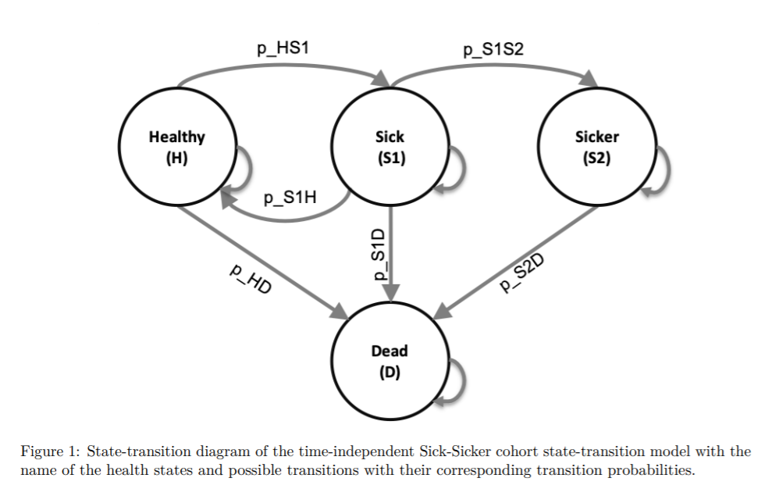
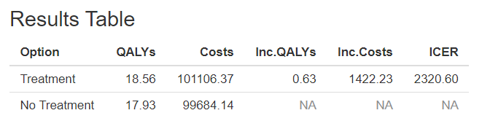
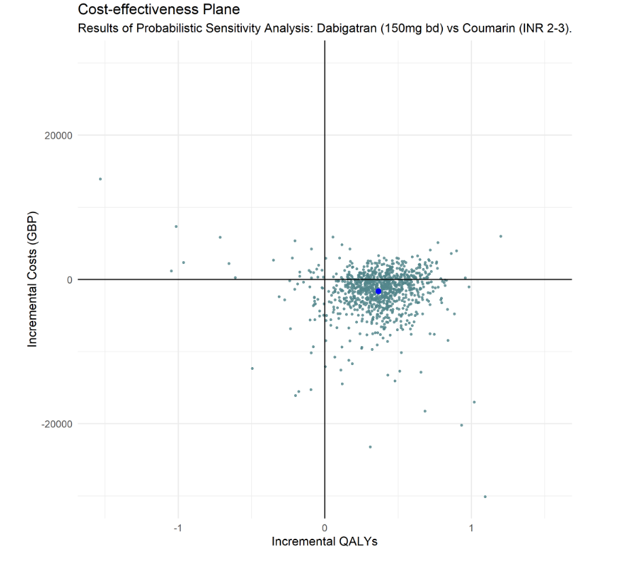
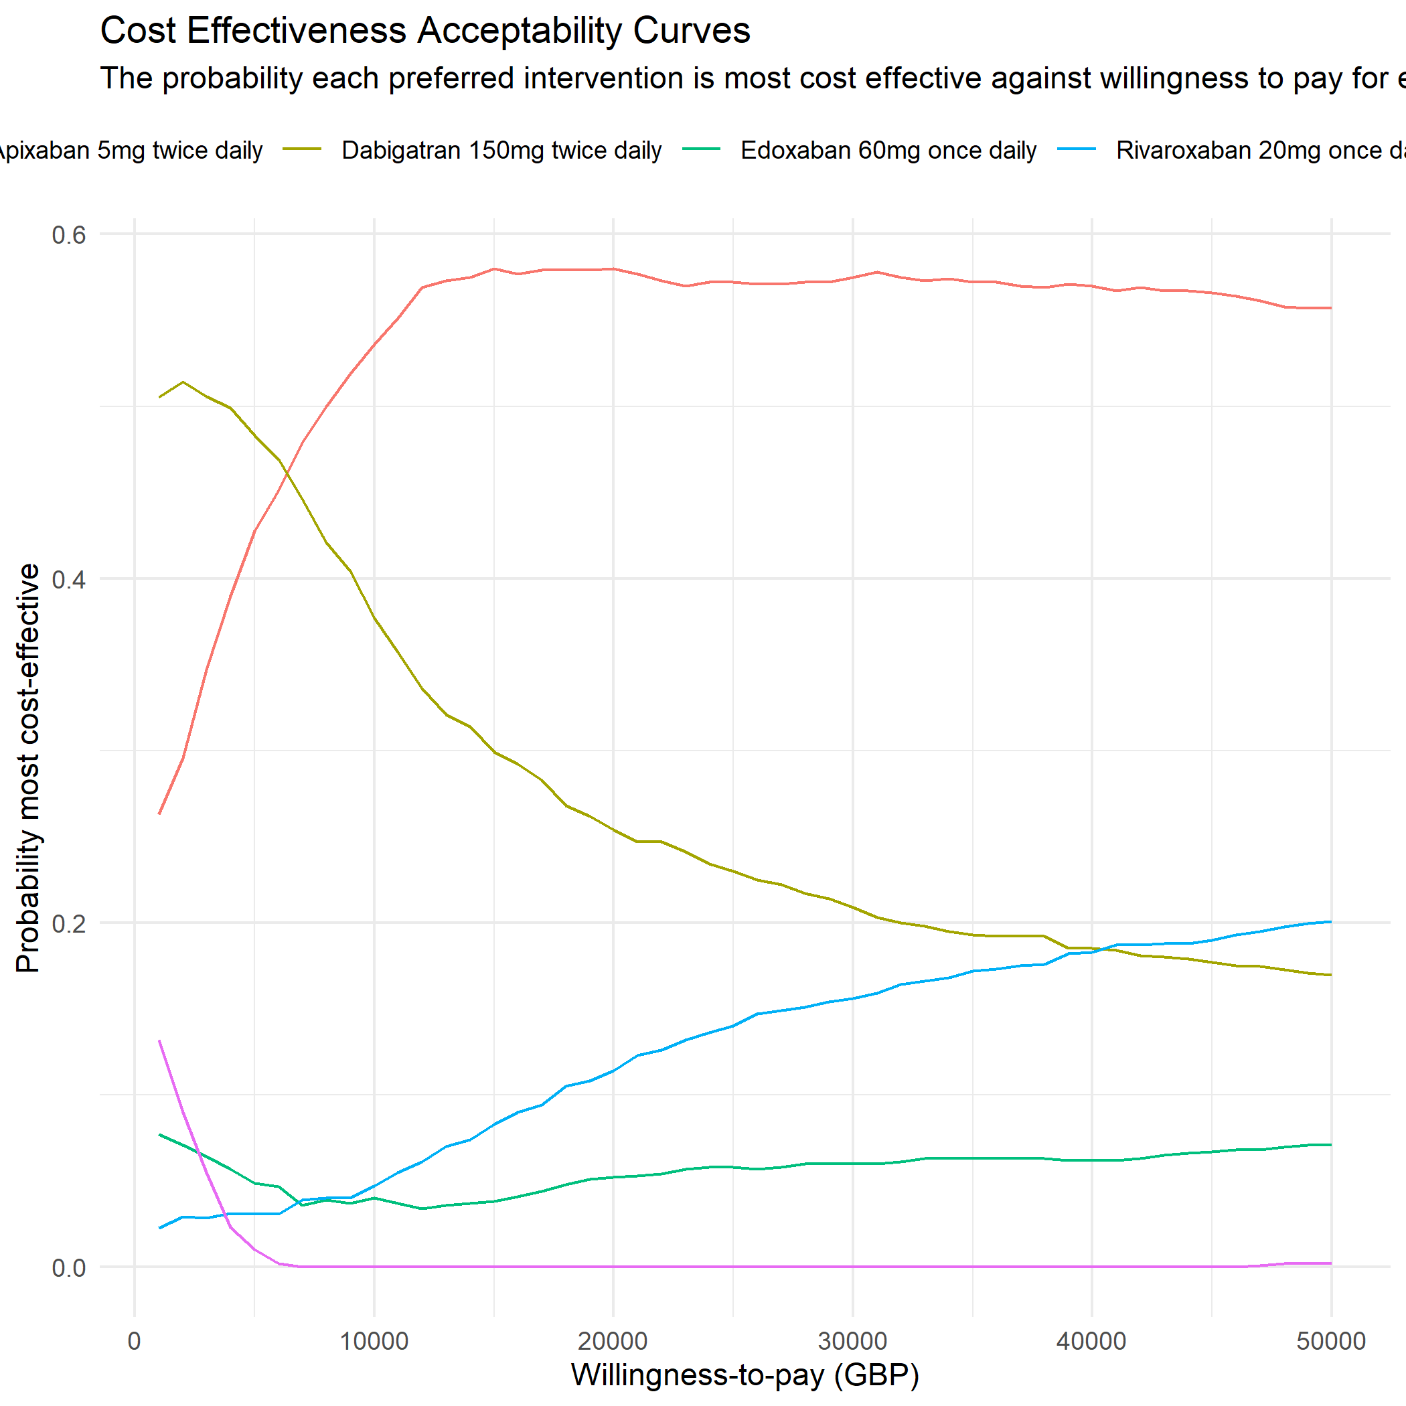
Inputs
Cost-effectiveness model in R
Function
Outputs
Parameters
c_s1 | cost1 | 3
c_s2 | cost2 | 5
c_H | cost3 | 6
dr | Dis_rate | 0.035
n_sim | No. psa | 1000

Slide 22
Steps
1. Understanding the model inputs and outputs.
2. Wrapping the model into a function.
3. Creating the app (iteratively adjusting user interface & server)
4. Deploying the app

Slide 23

Understanding the model inputs and outputs

Slide 24
DARTH Sick Sicker Model
https://github.com/RobertASmith/healthecon_shiny/tree/master/Tutorial

Slide 25

Wrapping the model into a function

Slide 26

Wrapping the model into a function

Slide 27
Inputs
Function
Outputs
Parameters
c_s1 | cost1 | 3
c_s2 | cost2 | 5
c_H | cost3 | 6
dr | Dis_rate | 0.035
n_sim | No. psa | 1000

Slide 28
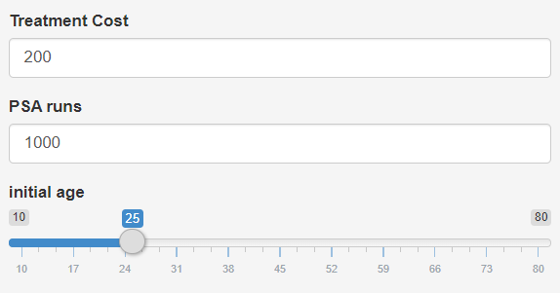
Inputs
Cost-effectiveness model in R-shiny
Function
Outputs
Parameters
c_s1 | cost1 | 3
c_s2 | cost2 | 5
c_H | cost3 | 6
dr | Dis_rate | 0.035
n_sim | No. psa | 1000

Slide 29

Creating the app

Slide 30

User Interface
Server
https://github.com/RobertASmith/healthecon_shiny/blob/master/App/app.R

Slide 31

Deploying the app

Slide 32
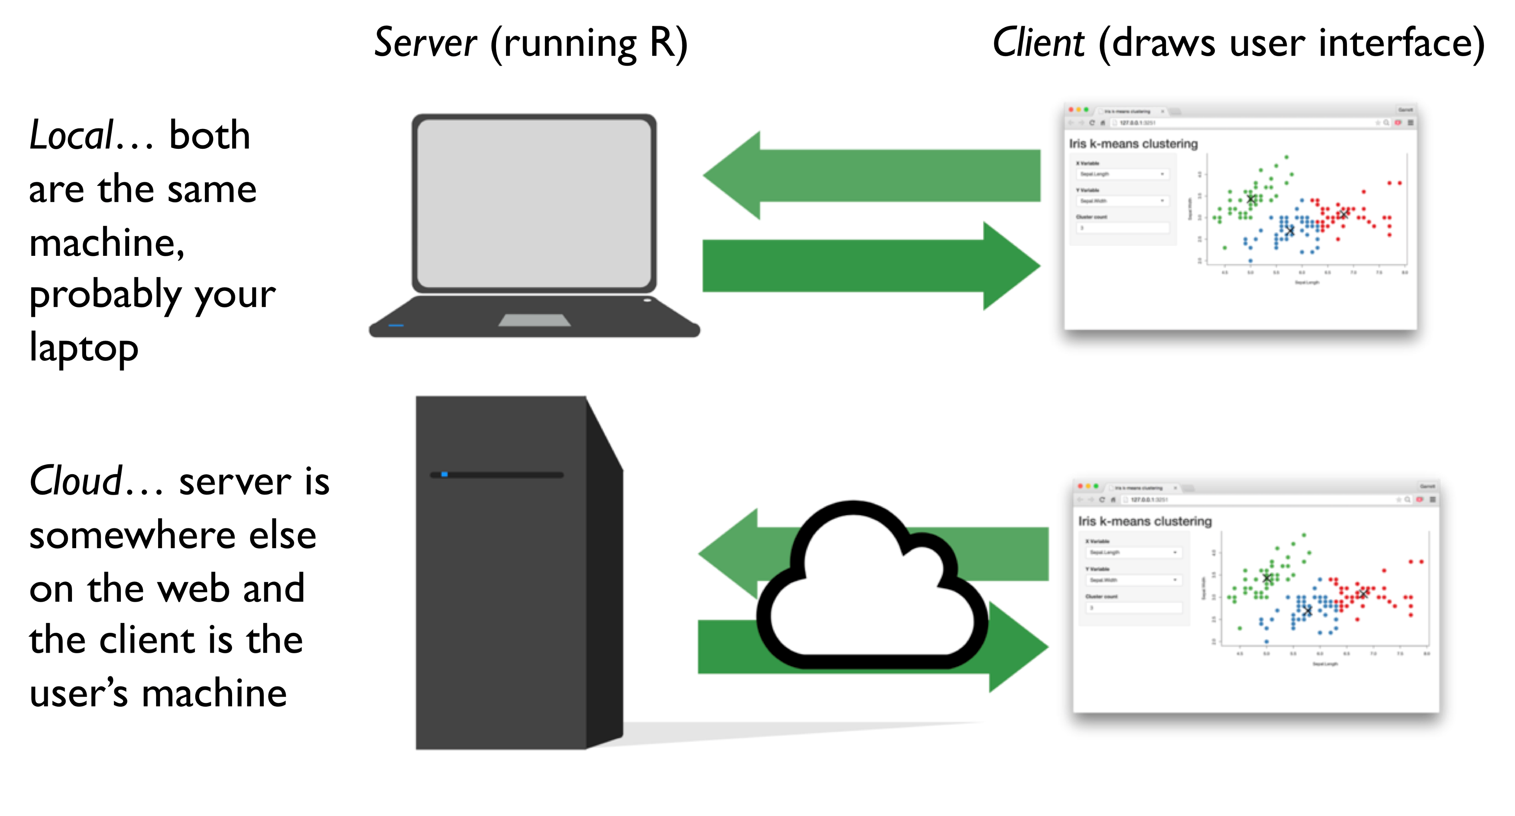
Whether to upload to the cloud?

Slide 33
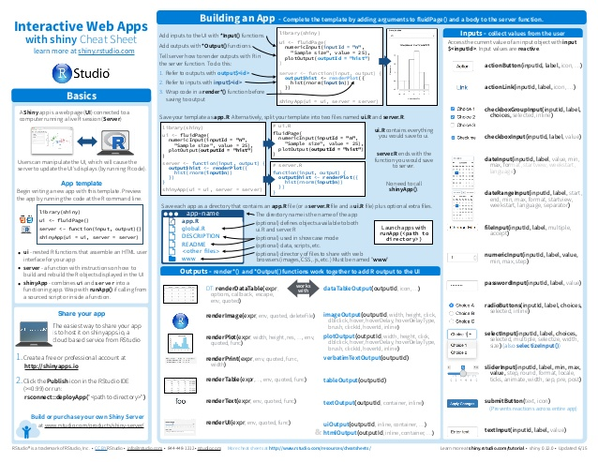

Further help …
https://blog.rstudio.com/2014/06/30/shiny-cheat-sheet/
http://darthworkgroup.com/

Slide 34


Shameless self promotion
R and Shiny for Health Economics?
https://www.sheffield.ac.uk/scharr/shortcourseunit/intror

Slide 35
Extra Slides

Slide 36
shinyApp function
User Interface
Non-interactive features
shiny inputs
shiny outputs
Server
Non-shiny inputs
Model Function (wrapper)
Plot & Table functions
Model Results

Slide 37
